Slide 1
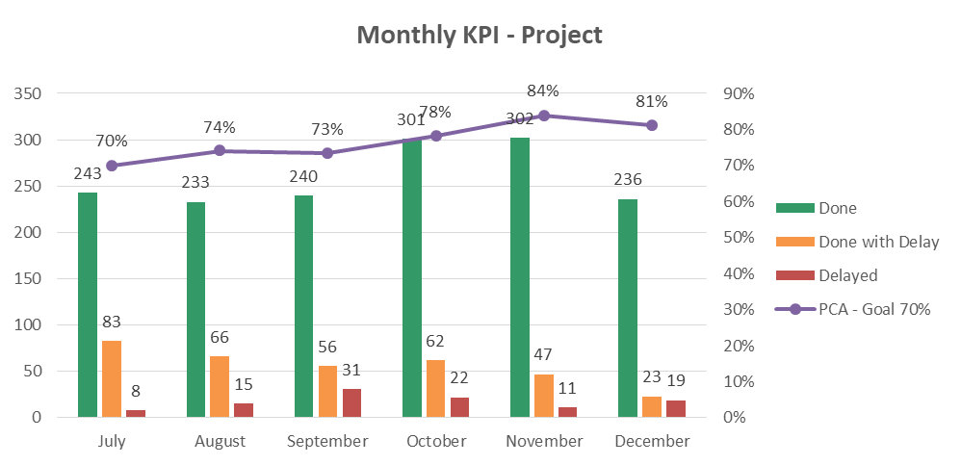
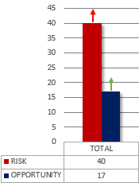
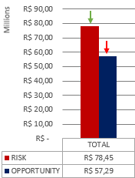
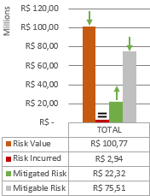
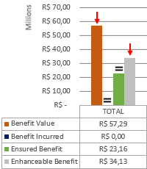
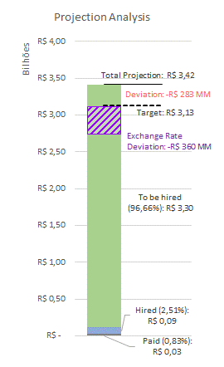
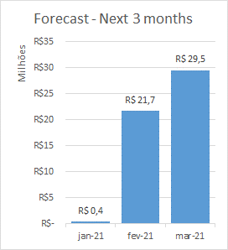
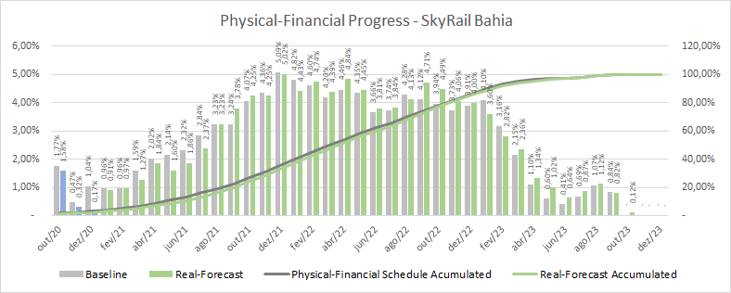
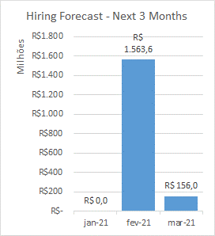
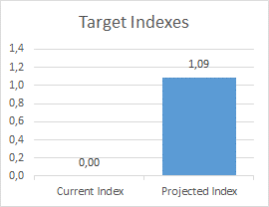
PROJECT
CIVIL
SYSTEMS
ROLLING STOCK
MONTHLY ACTION PLAN – Data base December/2020
RISK & OPPORTUNITY – Data base November/2020
QUANTITY
VALUE
RISK VALUE STATUS
OPPORTUNITY VALUE STATUS
FINANCIAL ANALYSIS – Data base December/2020
PHYSICAL-FINANCIAL PROGRESS – Data base December/2020
% Physical Progress (Dec/20):
Baseline: 1,04%
Real: 0,17%
% Physical Progress (Accumulated):
Baseline: 3,27%
Real: 2,07%

Slide 2
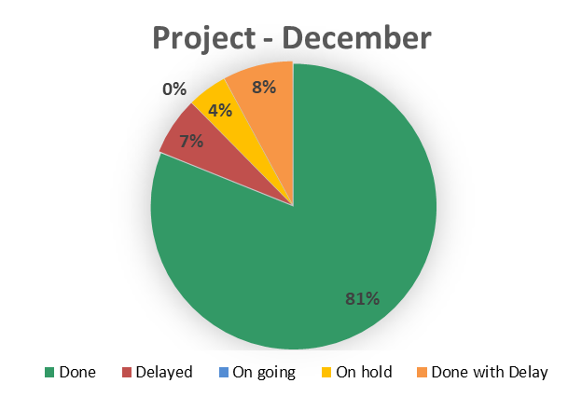
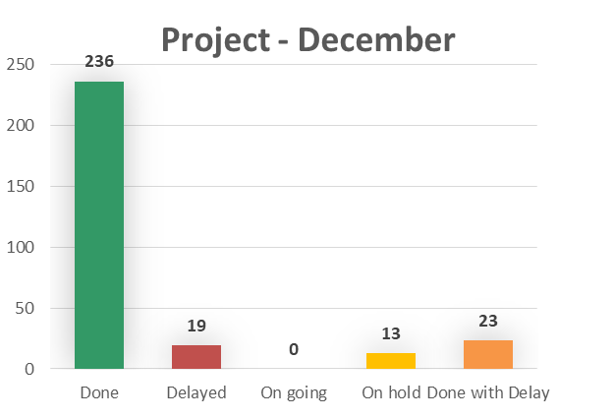
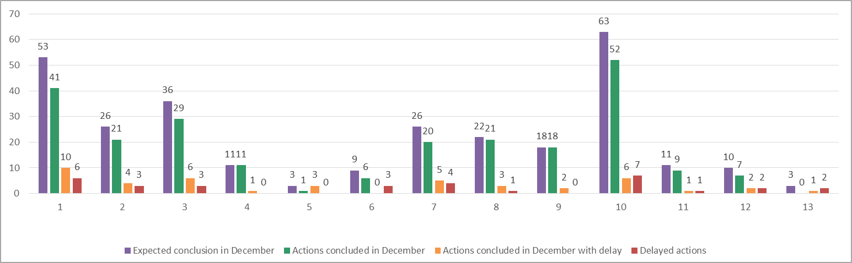
PROJECT
CIVIL
SYSTEMS
ROLLING STOCK
MONTHLY ACTION PLAN – Data base December/2020
STATUS OF ACTIONS BY DEPARTMENT

Slide 3
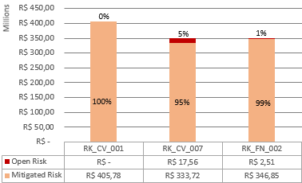
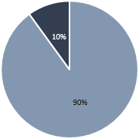
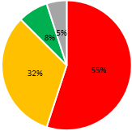
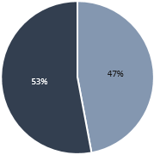
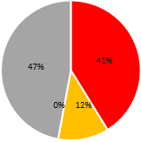
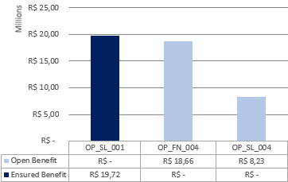



PROJECT
CIVIL
SYSTEMS
ROLLING STOCK
3 MAIN RISKS
RISK & OPPORTUNITY – Data base November/2020
QUANTITY
VALUE
RISK VALUE STATUS
OPPORTUNITY VALUE STATUS
RK_CV_001 – FAILURE TO ACHIEVE ECONOMIC REBALANCING DUE TO DELAY IN LICENSES/AUTHORIZATIONS
RK_CV_007 - DELAY IN IPHAN’S LICENSE AND AUTHORIZATIONS
RK_FN_002 - EXCHANGE RATE LOSS COMPARED TO THE BUDGET RATE
RISK
STATUS
OPPORTUNITY
STATUS
3 MAIN OPPORTUNITIES
MAIN COMMENTS
Balance: possible loss of R$ 29,45 millions, an improvement of R$ 20 millions, or 41%.
Risk quantity: 9 new risk, increase of 29%.
Risk value: R$ 34 millions decrease representing 30%
Opportunity quantity: 4 new, increase of 31%
Opportunity value: R$ 5 millions decrease, representing 8,5%
OP_SL_001 – EX-TARIFF FOR SIGNALING SYSTEM
OP_FN_004 – COST CONTROL PROCEDURE TO ACHIEVE THE TARGET
OP_SL_004 – EX-TARIFF FOR 3º & 4º RAIL

Slide 4
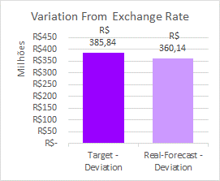
PROJECT
CIVIL
SYSTEMS
ROLLING STOCK
FINANCIAL ANALYSIS – Data Base December/2020
Main Payments – Next 3 months
January/2021
February/2021
March/2021
(Expropriation) IDEIAS studies adequation – R$ 108 K
(Studies and Designs) BMA / Rajendra – R$ 106 K
(License) RAIPA/PAIPA / Traffic Impact Study – R$ 82 K
(Curve Beaming Tooling) Delivery of 5 sets from NINIVE – R$ 17,0 MM
(EPC Company) Powerchina Preliminary Works – R$ 4,0 MM
(Expropriation) IDEIAS studies adequation – R$ 267 K
(Curve Beaming Tooling) Delivery of 3 sets from NINIVE / 3 sets Assembly / Spare Parts – R$ 11,0 MM
(Catwalk) Contract Downpayment – R$ 8,2 MM
(EPC Company) Powerchina Preliminary Works – R$ 5,9 MM
Main Hiring Contracts – Next 3 months
Main Deviations
Contract
Value
Month
Main Projected Deviations*
Train
Systems Div 21
Systems Div 23
Track Switch (Control System)
Track Switch (Beam)
R$ 1.003,9 MM
R$ 221,4 MM
R$ 308,7 MM
R$ 26,0 MM
R$ 73,1 MM
February/21
February/21
February/21
February/21
March/21
Contract
Value
%
EPC Company
Catwalk
Expropriation
Power Supply
Integration
Signaling
Depot
PSD
AFC
- R$ 285,18 MM
-R$ 30,33 MM
- R$ 25,98 MM
-R$ 21,70 MM
- R$ 18,00 MM
R$ 43,90 MM
R$ 30,50 MM
R$ 12,34 MM
R$ 8,87 MM
-24,91%
-53,13%
-77,35%
-16,56%
-
19,65%
67,50%
20,79%
31,15%
Variation between projections with the current currency quotation and projections with the Budget dollar quotation R$ 4,07.
Current Currency Quotations:
Dollar quotation R$ 5,35
Euro quotation R$ 6,48
Pound quotation R$ 7,29
* Comparing to Target

Slide 5
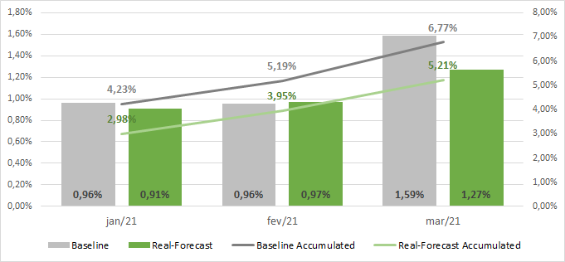
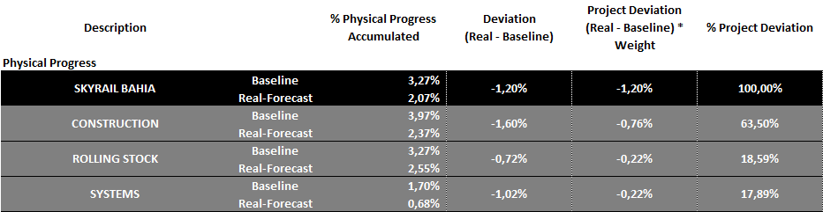


PROJECT
CIVIL
SYSTEMS
ROLLING STOCK
PHYSICAL PROGRESS FORECAST – Next 3 months
MAIN DEVIATIONS
ATTENTION POINTS
IDB Financing Contract
Deadline: 15/Feb/2021*
Current Status: Waiting for the IDB committee report
Impact: If we couldn’t solve it, it will postpone the start of expropriation, the rolling stock and systems hiring. As a consequence, it will impact the operational landmarks 01, 02 and 03.
*Estimated date
Train Stop
Deadline: 15/Feb/2021
Current Status: Official Letter from the Government received on 15/Jan/2021. Process is ongoing.
Impact: After the deadline above, it will postpone the operational landmarks 01, 02 and 03.
Power Supply and AFC Contract Signature
Deadline: 12/Feb/2021
Current Status: Discussing open points with BYD China. However, it´s important to single out that the Chinese New Year´s holidays will be between February 1st and 12th.
Impact: After the deadline above, it will postpone the operational landmarks 01, 02 and 03.
PHYSICAL-FINANCIAL PROGRESS – Data base December/2020
% Physical Progress (Dec/20):
Baseline: 1,04%
Real: 0,17%
% Physical Progress (Accumulated):
Baseline: 3,27%
Real: 2,07%
ACTION PLAN FOLLOW UP
CIVIL
ROLLING STOCK
TRACK SWITCH / DEPOT
SYSTEMS

Slide 6
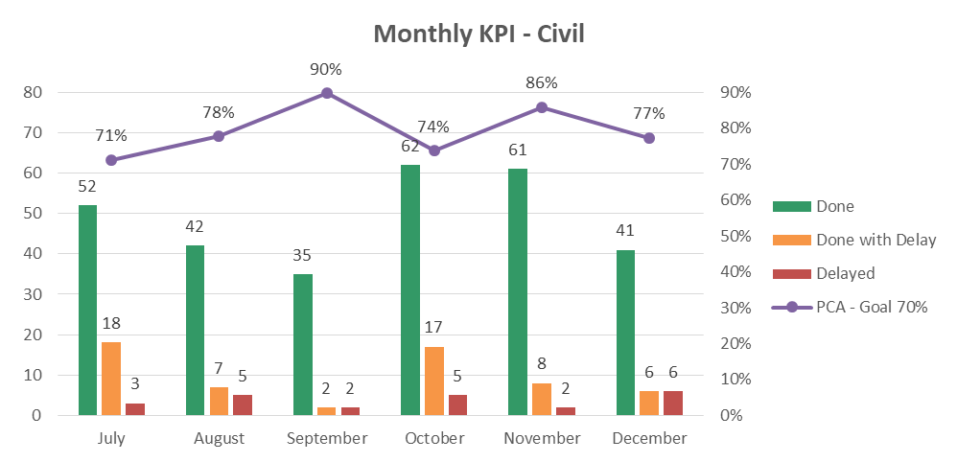
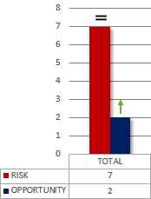
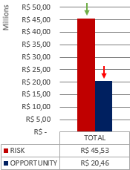
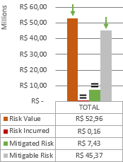
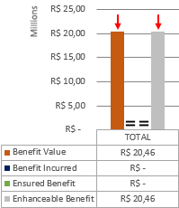
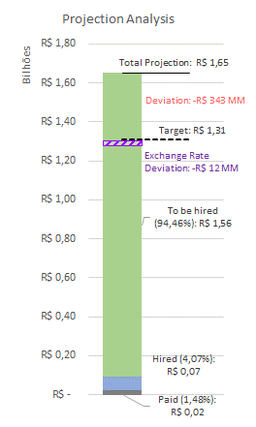

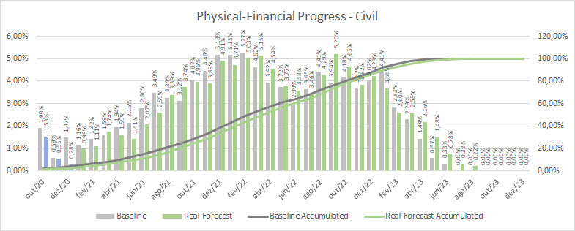
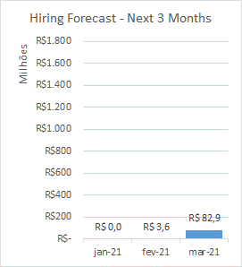
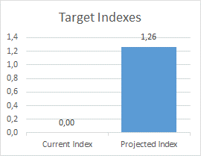
PROJECT
CIVIL
SYSTEMS
ROLLING STOCK
MONTHLY ACTION PLAN – Data base December/2020
RISK & OPPORTUNITY – Data base November/2020
QUANTITY
VALUE
RISK VALUE STATUS
OPPORTUNITY VALUE STATUS
FINANCIAL ANALYSIS – Data base December/2020
PHYSICAL-FINANCIAL PROGRESS – Data base December/2020
% Physical Progress (Dec/20):
Baseline: 1,47%
Real: 0,28%
% Physical Progress (Accumulated):
Baseline: 3,97%
Real: 2,37%

Slide 7
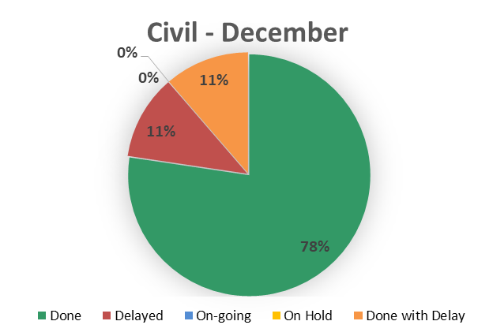
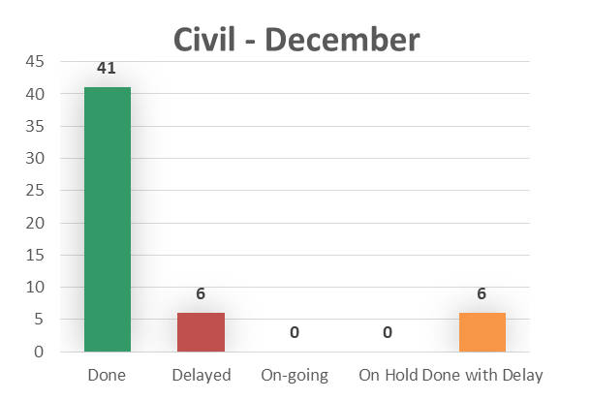
PROJECT
CIVIL
SYSTEMS
ROLLING STOCK
MONTHLY ACTION PLAN – Data base December/2020
ACTIONS DELAYED / ON-HOLD
Action | Department | Finish | Postponed Date | Status
Check real estate registration of Calçada's land in notary's office | Civil | 11-dez-20 | 15-jan-21 | Delayed
Develop worksheet to control physical progress of the construction | Civil | 18-dez-20 | 29-jan-21 | Delayed
Do field surveys to analyze the possible affect of the definitive fence along the alignment | Civil | 18-dez-20 |  | Delayed
Close the deal with Gerdau | Civil | 11-dez-20 | 15-jan-21 | Delayed

Slide 8
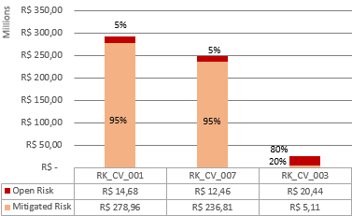
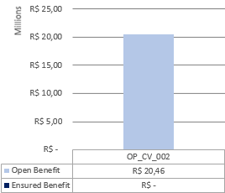
PROJECT
CIVIL
SYSTEMS
ROLLING STOCK
3 MAIN RISKS
RISK & OPPORTUNITY – Data base November/2020
QUANTITY
VALUE
RISK VALUE STATUS
OPPORTUNITY VALUE STATUS
RK_CV_001 - DELAY IN LICENSES AND AUTHORIZATIONS
RK_CV_007 - DELAY IN LICENSES AND AUTHORIZATIONS FROM IPHAN
RK_CV_003 - EXPROPRIATION EXTRA VALUE, DUE TO PS5 FROM IFC
MAIN COMMENTS
3 MAIN OPPORTUNITIES
Risk quantity: the same of September.
Risk value: decrease of 27%
Opportunity value: 59% decrease
Opportunity quantity: 1 new, possibility of earn a discount reducing the Catwalk scope
OP_CV_002 – EARN A DISCOUNT ON CATWALK CONTRACT BY REDUCING THE SCOPE

Slide 9
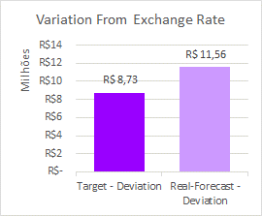
PROJECT
CIVIL
SYSTEMS
ROLLING STOCK
FINANCIAL ANALYSIS – Data Base December/2020
Main Payments – Next 3 months
January/2021
February/2021
March/2021
(Expropriation) IDEIAS studies adequation – R$ 108 K
(Studies and Designs) BMA / Rajendra – R$ 106 K
(License) RAIPA/PAIPA / Traffic Impact Study – R$ 82 K
(Curve Beaming Tooling) Delivery of 5 sets from NINIVE – R$ 17,0 MM
(EPC Company) Powerchina Preliminary Works – R$ 4,0 MM
(Expropriation) IDEIAS studies adequation – R$ 267 K
(Curve Beaming Tooling) Delivery of 3 sets from NINIVE / 3 sets Assembly / Spare Parts – R$ 11,0 MM
(Catwalk) Contract Downpayment – R$ 8,2 MM
(EPC Company) Powerchina Preliminary Works – R$ 5,9 MM
Main Hiring Contracts – Next 3 months
Main Deviations
Contract
Value
Month
Main Projected Deviations*
Contract
Value
%
Catwalk
R$ 82,2 MM
March/21
EPC Company
Catwalk
Expropriation
Cables & Support
Provision
Bumper
Studies and designs Phases 01 & 02
Camp Site
- R$ 285,18 MM
-R$ 30,33 MM
- R$ 25,98 MM
- R$ 13,99 MM
R$ 19,23 MM
R$ 0,80 MM
R$ 0,17 MM
R$ 0,13 MM
-24,91%
-53,13%
-77,35%
-225,06%
99,18%
100,00%
2,71%
6,28%
Variation between projections with the current currency quotation and projections with the Budget dollar quotation R$ 4,07.
Current Currency Quotations:
Dollar quotation R$ 5,35
Euro quotation R$ 6,48
Pound quotation R$ 7,29
* Comparing to Target

Slide 10
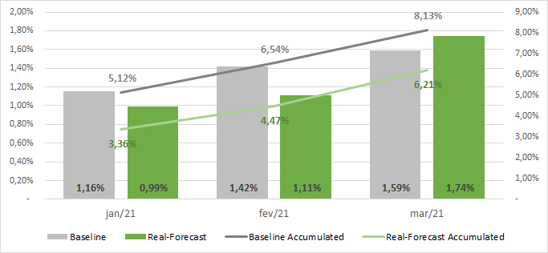
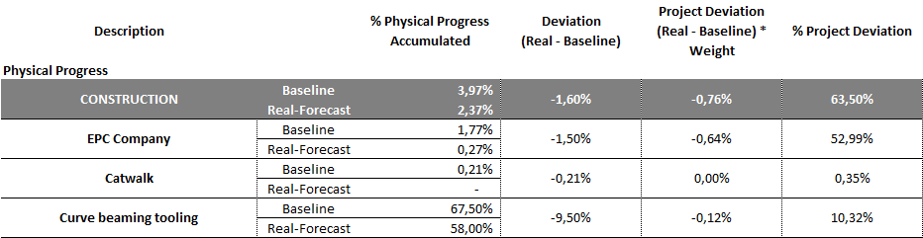
PROJECT
CIVIL
SYSTEMS
ROLLING STOCK
PHYSICAL PROGRESS FORECAST – Next 3 months
MAIN DEVIATIONS
ATTENTION POINTS
Full Scope EPC Company Contract
Deadline: 03/Apr/2021
Current Status: Waiting for Powerchina’s and Marquise's commercial proposal reviewed. The IDB Financing Contract resolution also impact on EPC hiring.
Impact: The preliminary EPC contract was planned to end on May 4. After the above period, the Project runs the risk of being without an EPC Company.
Curved Beam port storage fee
Deadline: 03/Feb/2021
Current Status: Waiting for some Powerchina’s subcontractors documents and the Gerdau Contract hiring.
Impact: After the deadline above, the Project will have to pay a fee of R$ 48,6K for each 10 days of port storage.
Environmental License Update - Changing the Precast Site to USIBA area
Deadline: 05/Feb/2021 (Start of USIBA land clearing)
Current Status: Preparing the documentation to protocol the Environmental License Update on February 1st.
Impact: After the deadline above, it will postpone the Beam Fabrication start.
PHYSICAL-FINANCIAL PROGRESS – Data base December/2020
% Physical Progress (Dec/20):
Baseline: 1,47%
Real: 0,28%
% Physical Progress (Accumulated):
Baseline: 3,97%
Real: 2,37%
ACTION PLAN FOLLOW UP
Topography (Waiting for the Action Plan)
Soil Survey (Waiting for the Action Plan)
Load Test (Waiting for the Action Plan)
Working on the Action Plans due to the new train stop date – Deadline: 12/Feb/2021

Slide 11
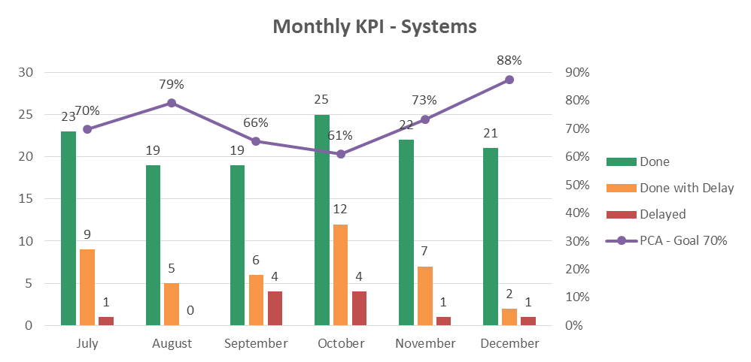
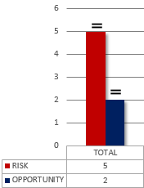
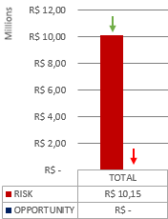
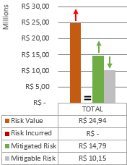
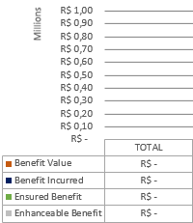
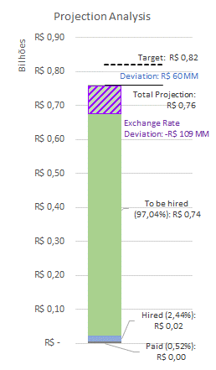
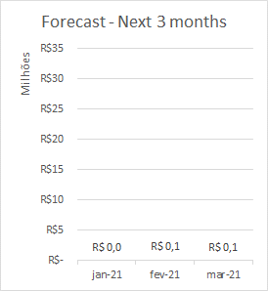
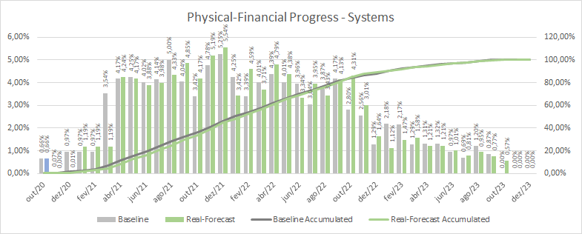
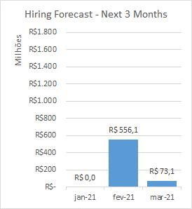
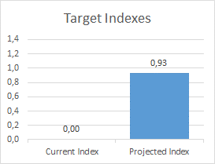
PROJECT
CIVIL
SYSTEMS
ROLLING STOCK
MONTHLY ACTION PLAN – Data base December/2020
RISK & OPPORTUNITY – Data base November/2020
QUANTITY
VALUE
RISK VALUE STATUS
OPPORTUNITY VALUE STATUS
FINANCIAL ANALYSIS – Data base December/2020
PHYSICAL-FINANCIAL PROGRESS – Data base December/2020
% Physical Progress (Dec/20):
Baseline: 0,97%
Real: 0,01%
% Physical Progress (Accumulated):
Baseline: 1,70%
Real: 0,68%

Slide 12
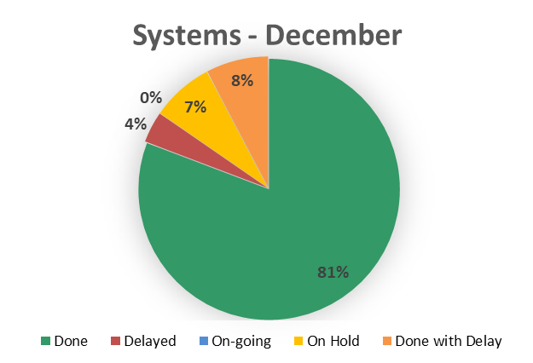
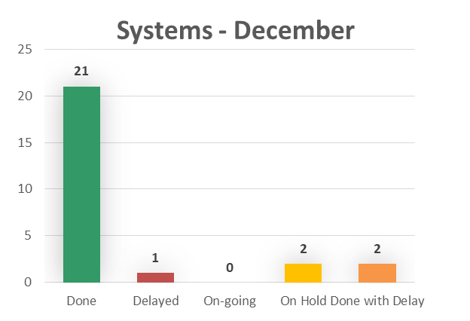
PROJECT
CIVIL
SYSTEMS
ROLLING STOCK
MONTHLY ACTION PLAN – Data base December/2020
ACTIONS DELAYED / ON-HOLD
Action | Department | Finish | Postponed Date | Status
Cable tray Reference term updating | Systems | 15-dez-20 |  | On Hold
Elaborating of the UPS´s RDM for the PDS System | Systems | 18-dez-20 | 29-jan-21 | Delayed
Physical-financial schedule creation for Sener´s contract control | Systems | 18-dez-20 |  | On Hold

Slide 13


PROJECT
CIVIL
SYSTEMS
ROLLING STOCK
3 MAIN RISKS
RISK & OPPORTUNITY – Data base November/2020
QUANTITY
VALUE
RISK VALUE STATUS
OPPORTUNITY VALUE STATUS
RK_ST_002 - NOT APPROVAL OF LTE-U TECHNOLOGY BY CTB & ANATEL
RK_ST_005 - MISCALCULATED CAPEX OF CABLE TRAYS
RK_ST_001 – DELAY DEFINITION OF POWER SUPPLY FINAL SUPPLIER
MAIN COMMENTS
3 MAIN OPPORTUNITIES
Risk quantity: the same of September.
Risk value: 35% decrease
Mitigated risk: 1 representing avoiding an extra expense of R$ 14.790.392,48
Opportunity value: 100% decrease,
Opportunity quantity: the same of September
NO OPPORTUNITY THIS MONTH

Slide 14

PROJECT
CIVIL
SYSTEMS
ROLLING STOCK
FINANCIAL ANALYSIS – Data Base December/2020
Main Payments – Next 3 months
January/2021
February/2021
March/2021
No System Payment
(Systems Design) Sener First delivery of executive design – R$ 99,2 K
(Systems Design) Sener First delivery of executive design – R$ 93,0 K
Main Hiring Contracts – Next 3 months
Main Hiring Contracts – Next 3 months
Main Deviations
Contract
Value
Month
Main Projected Deviations*
Signaling
Power Supply
Telecom
3rd and 4th Rails
PSD
Track Switch (Control System)
R$ 166,8 MM
R$ 112,3 MM
R$ 99,1 MM
R$ 73,5 MM
R$ 35,7 MM
R$ 26,0 MM
February/21
February/21
February/21
February/21
February/21
February/21
Contract
Value
%
Power Supply
Integration
Communication
Maintenance Vehicle
Signaling
Depot
PSD
AFC
Track Switch
-R$ 21,70 MM
- R$ 18,00 MM
- R$ 8,99 MM
- R$ 1,46 MM
R$ 43,90 MM
R$ 30,50 MM
R$ 12,34 MM
R$ 8,87 MM
R$ 8,80 MM
-16,56%
-
-9,19%
-16,36%
19,65%
67,50%
20,79%
31,15%
8,10%
Variation between projections with the current currency quotation and projections with the Budget dollar quotation R$ 4,07.
Current Currency Quotations:
Dollar quotation R$ 5,35
Euro quotation R$ 6,48
Pound quotation R$ 7,29
* Comparing to Target

Slide 15


PROJECT
CIVIL
SYSTEMS
ROLLING STOCK
PHYSICAL PROGRESS FORECAST – Next 3 months
MAIN DEVIATIONS
ATTENTION POINTS
Systems Contract Signature
Deadline 1: 12/Feb/2021* (Power Supply and AFC)
Deadline 2: 26/Feb/2021* (3rd and 4th Rail and PSD)
Deadline 3: 10/Mar/2021* (UPS, Telecom, Signaling and Integrated Supervisory Control System)
Current Status: Discussing open points with BYD China. However, it´s important to single out that the Chinese New Year´s holidays will be between February 1st and 12th. The IDB Financing Contract resolution also impact on Systems Contract Hiring.
Impact: After the deadline above, it will postpone the operational landmarks 01, 02 and 03.
Systems Design Inputs (From Civil)
Deadline: Late. The new forecast for the Documentation List delivery is February 12th.
Current Status: Waiting for the delivery schedule of the Documentation List from Powerchina.
Impact: SENER has already some difficulties because of this missing inputs. This lack of information also impacts our planning precision.
*According to the current implementation schedule
PHYSICAL-FINANCIAL PROGRESS – Data base December/2020
% Physical Progress (Dec/20):
Baseline: 0,97%
Real: 0,01%
% Physical Progress (Accumulated):
Baseline: 1,70%
Real: 0,68%
ACTION PLAN FOLLOW UP
Working on the Action Plans due to the new train stop date – Deadline: 12/Feb/2021

Slide 16









PROJECT
CIVIL
SYSTEMS
ROLLING STOCK
MONTHLY ACTION PLAN – Data base December/2020
RISK & OPPORTUNITY – Data base November/2020
QUANTITY
VALUE
RISK VALUE STATUS
OPPORTUNITY VALUE STATUS
FINANCIAL ANALYSIS – Data base December/2020
PHYSICAL-FINANCIAL PROGRESS – Data base December/2020
% Physical Progress (Dec/20):
Baseline: 0,41%
Real: 0,10%
% Physical Progress (Accumulated):
Baseline: 3,27%
Real: 2,55%

Slide 17


PROJECT
CIVIL
SYSTEMS
ROLLING STOCK
MONTHLY ACTION PLAN – Data base December/2020
ACTIONS DELAYED / ON-HOLD
Action | Department | Finish | Postponed Date | Status
Send to CTB the sticker documentation | Rolling Stock | 4-dez-20 |  | On Hold
Meeting with Aliandro to discuss the Concession Agreement |  | 11-dez-20 | 27-jan-21 | Delayed

Slide 18

PROJECT
CIVIL
SYSTEMS
ROLLING STOCK
3 MAIN RISKS
RISK & OPPORTUNITY – Data base November/2020
QUANTITY
VALUE
RISK VALUE STATUS
OPPORTUNITY VALUE STATUS
RK_RS_007 – MIV CAPEX DO NOT COMPLY WITH MARKET PRICE
RK_RS_001 – DELAY IN THE TRACK SWITCH CONTRACT
RK_RS_004 – DELAY IN PROJECT DUE NON-ACCEPTANCE OF THE TRAIN
MAIN COMMENTS
3 MAIN OPPORTUNITIES
Risk quantity: 2 new.
Risk closed: 1 closed.
Risk value: 40% increase
Opportunity value: 100% decrease
Opportunity quantity: the same of September.
NO OPPORTUNITY THIS MONTH

Slide 19

PROJECT
CIVIL
SYSTEMS
ROLLING STOCK
FINANCIAL ANALYSIS – Data Base December/2020
Main Payments – Next 3 months
January/2021
February/2021
March/2021
No Rolling Stock Payments
No Rolling Stock Payments
No Rolling Stock Payments
Main Hiring Contracts – Next 3 months
Main Hiring Contracts – Next 3 months
Main Deviations
Contract
Value
Month
Main Projected Deviations**
Contract
Value
%
Train
Track Switch (Control System)*
Track Switch (Beam)*
R$ 1.003,9 MM
R$ 26,0 MM
R$ 73,1 MM
February/21
February/21
March/21
Train
Maintenance Vehicle*
Depot*
Track Switch*
-
- R$ 1,46 MM
R$ 30,50 MM
R$ 8,80 MM
-
-16,36%
67,50%
8,10%
Variation between projections with the current currency quotation and projections with the Budget dollar quotation R$ 4,07.
Current Currency Quotations:
Dollar quotation R$ 5,35
Euro quotation R$ 6,48
Pound quotation R$ 7,29
* Items included in the Systems Budget, but managed by Rolling Stock Team
** Comparing to Target

Slide 20


PROJECT
CIVIL
SYSTEMS
ROLLING STOCK
PHYSICAL PROGRESS FORECAST – Next 3 months
MAIN DEVIATIONS
ATTENTION POINTS
Train Contract Signature
Deadline: 15/Mar/2021
Current Status: The Contract have already been aligned with BYD China. However, we are waiting for the IDB report to finish the hiring process.
Impact: Even the contract signature do not postpone the 1st train fabrication start, BYD China requested the Contract signed to send us the test documentation. After the deadline above, it will postpone the CTB planned test documentation approval.
Track Switch Contract Signature
Deadline 1: 15/Mar/2021 – Control System
Deadline 2: 05/Apr/2021 – Beam (21 days after deadline 1)
Current Status: The Contract have already been aligned with BYD China. We are up to send the contract to IDB analysis.
Impact: If we miss the deadline 1, consequently the deadline 2 will be postponed. Therefore, it will postpone the fabrication start. It is important to single out that the concentration of simultaneous Track Switch fabrication and assembly is on the Operational Landmark 01 (7 simultaneous).
PHYSICAL-FINANCIAL PROGRESS – Data base December/2020
% Physical Progress (Dec/20):
Baseline: 0,41%
Real: 0,10%
% Physical Progress (Accumulated):
Baseline: 3,27%
Real: 2,55%
ACTION PLAN FOLLOW UP
Working on the Action Plans due to the new train stop date – Deadline: 12/Feb/2021

